Slide 1
Quality Datasets
Notes:
In this video, we’ll learn how to determine the usability of a dataset and why it’s important to use one of high quality!

Slide 2

Completeness
Completeness is the degree in which all required data is known. It is the absence of missing values.
Notes:
There are a few different criteria to consider when determining the quality of the dataset you would like to use. We’ve already learned a bit about this during the data cleaning lesson in a previous module. The completeness of a dataset is very important and a key principle in figuring out the quality of a dataset. Missing values can detract from a dataset’s usability. We’ve learned that you can take steps to remove or replace missing values, but this leaves room for error, or even bias in your data.

Slide 3
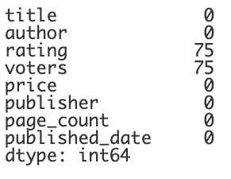
Missing Values
print(df.isnull().sum())
Notes:
A quick way to see how much of your data is missing is to use a percentage. We can do this by using a few different functions. The isnull function and the sum function will help to see the total number of missing values. Here we see that we are missing 75 values in the ratings columns and 75 in the voters column. This means there are 150 missing values which sounds like a lot - however some of these datasets are huge, so finding the percentage will help adjust what these numbers actually mean.

Slide 4
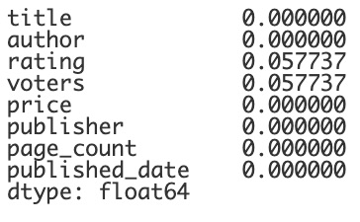
Missing Values
print(df.isnull().mean())
Notes:
If we use the mean function instead of the sum function, it will give us the decimal fraction of the values that are missing.

Slide 5
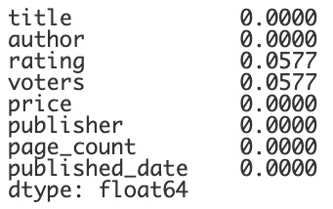
Missing Values
print(df.isnull().mean().round(4))
Notes:
We can clean it up a bit by rounding.

Slide 6
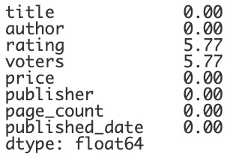
Missing Values
print(df.isnull().mean().round(4) * 100)
Notes:
We can also multiply by 100 to clearly see the percentage. This shows that only 5.77% of values are missing in the rating and voters columns. Even though this is a relatively small percent of the dataset, you'd still want to investigate to see if this missing data is random or representative of a certain subgroup, to avoid bad or biased data.

Slide 7
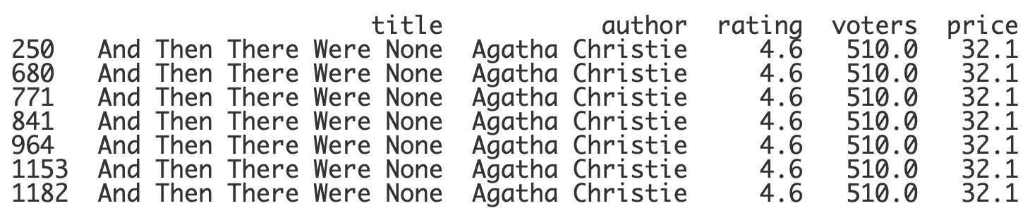
Uniqueness
Uniqueness is a metric used to ensure that a piece of data has only been recorded once and is not duplicated in the dataset.
Notes:
Another factor that can affect a dataset’s quality is its uniqueness. This metric has to do with duplicate entries. In the book dataset that we have been using, we can see that there are a lot of duplicate records. This can throw off the data a lot. Even our earlier percentage of missing values is now not reliable since there are so many duplicate rows.

Slide 8
Review: Duplicate Rows
print(df.duplicated().sum())
df.drop_duplicates(inplace=True)
print(df.duplicated().sum())
print(df.duplicated().sum())
0
1052
Notes:
Luckily, we’ve learned of a simple function that can drop these duplicate results. As you can see, this dataset contains a LOT of duplicate rows. We can drop these duplicates to increase the quality of the dataset.

Slide 9
Validity and Accuracy
The validity of data depends on whether it matches the type of data that was expected.
The accuracy of data depends on whether or not the data is correct.
Zip Code:
tomato
Zip Code:
12345
Notes:
Two other factors that contribute to the quality of a dataset are the validity and accuracy of the data. These two criteria are similar in nature. The validity of a piece of data deals with whether the correct piece of data was recorded. If you asked for someone’s zip code and they enter tomato, this is not a valid piece of data. The accuracy, on the other hand, depends on the correctness of the data. If a person doesn’t know their zip code and just enters 12345, well this is valid data but it’s not accurate. The validity of data is much less difficult to find and clean than the accuracy of data. How can you tell if a piece of data was recorded with accuracy? Well, one way to do this would be to consider and compare a few different datasets.

Slide 10
Consistency
Consistency refers to data values in one data set being collected and stored in the same way as values in another data set.
Age:
Age:
Age:
10
10.5
ten
Notes:
And this is where the the last criteria comes into play. The consistency of a dataset is important to be able to compare or merge different datasets. There should be consistency in the units of measure used or the way that data is collected. If you are collecting the ages of a group, it would be very difficult to compare across datasets if someone could enter only integers in one dataset, floats in another and strings in a third. Lacking consistency would make it hard to work together between datasets.

Slide 11
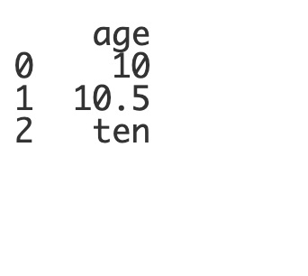
Replace Values
print(df)
Notes:
We can fix issues with the consistency of our data in a few ways. One is with the replace function. Let’s say this is our data frame that holds these inconsistent values.

Slide 12
Replace Values
df.age.replace()
Notes:
We can denote the dataframe and the column and use the replace function to make changes.

Slide 13
Replace Values
df.age.replace(to_replace = , value = )
Notes:
The replace function takes a to_replace parameter which is the value or values that will change and a value parameter which is what the values will change to.

Slide 14
Replace Values
df.age.replace(to_replace = "ten", value = )
Notes:
You can put one value at a time in the to_replace parameter

Slide 15
Replace Values
df.age.replace(to_replace =["ten", 10.5], value = )
Notes:
Or you can use a list of multiple values to change. Now, as with any change, you’ll want to really consider how changing the data might affect the accuracy of the dataset. You don’t want to round or change numbers if it will negatively affect your dataset. Let’s say, in this case, the half year is not important and we want to change the 10.5 and the string 10 to

Slide 16
Replace Values
df.age.replace(to_replace =["ten", 10.5], value = 10)
Notes:
An integer of 10.

Slide 17
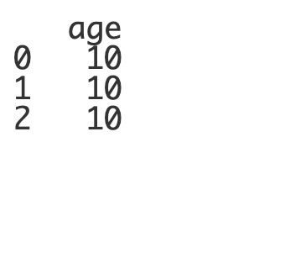
Replace Values
df.age.replace(to_replace =["ten", 10.5], value = 10, inplace=True)
print(df)
Notes:
Since we’d like this change to be permanent, we must also add in the inplace parameter and set it equal to True. When we print out the dataframe again, we can see that we have fixed the inconsistencies between these three values.

Slide 18
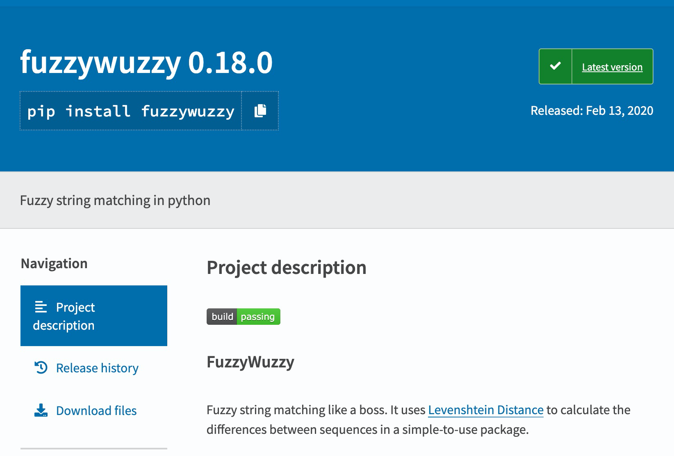
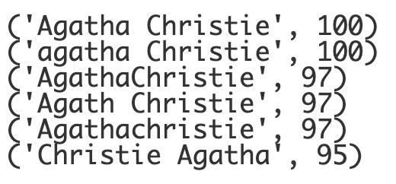
Fuzzy Matching
Notes:
You might be thinking how could you possibly find all of these inconsistencies in a huge dataset? The python library called fuzzywuzzy can help with this. This library compares different strings and scores them based on how similar they are to each other. For instance, if we are trying to find books by Agatha Christie and want to make sure that our data is consistent, fuzzywuzzy can be used to find similar strings. This will help us to find these discrepancies and replace the values. Let’s take a look at how this library works!

Slide 19
Lesson Vocabulary
Term | Definition
completeness | The degree in which all required data is known. It is the absence of missing values.
uniqueness | A metric used to ensure that a piece of data has only been recorded once and is not duplicated in the dataset.
validity | Depends on whether the data matches the type of data that was expected.
accuracy | Depends on whether or not the data is correct.
consistency | Refers to data values in one data set being collected and stored in the same way as values in another data set.

